Slide 1

HTML Project
ITST-1101
Columbus State Community College
Professor David Flom
Submitted by: Jordan Hurley

Slide 2

Hockey
I’ve been a hockey fan for years now and I've always cheered for the Columbus Blue Jackets. I chose to make a webpage about the Columbus Blue Jackets because they are my favorite sports team.

Slide 3
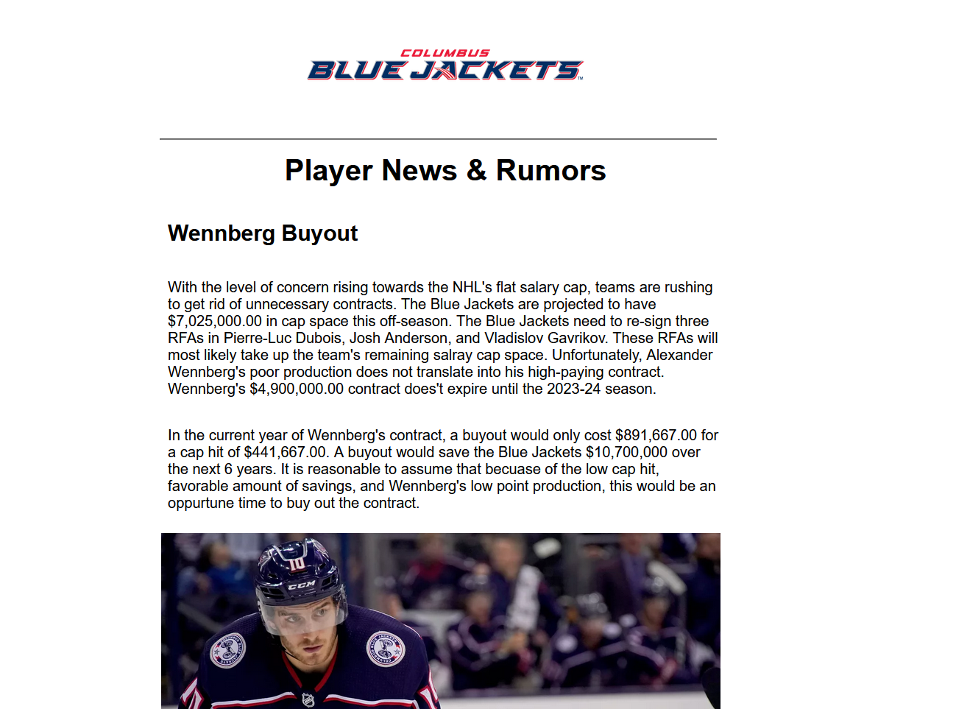
Columbus Blue Jackets FANSITE
News Webpage directed towards Fans of the Columbus Blue Jackets
Provides Team Information; Player News, Statistics and Rumors

Slide 4
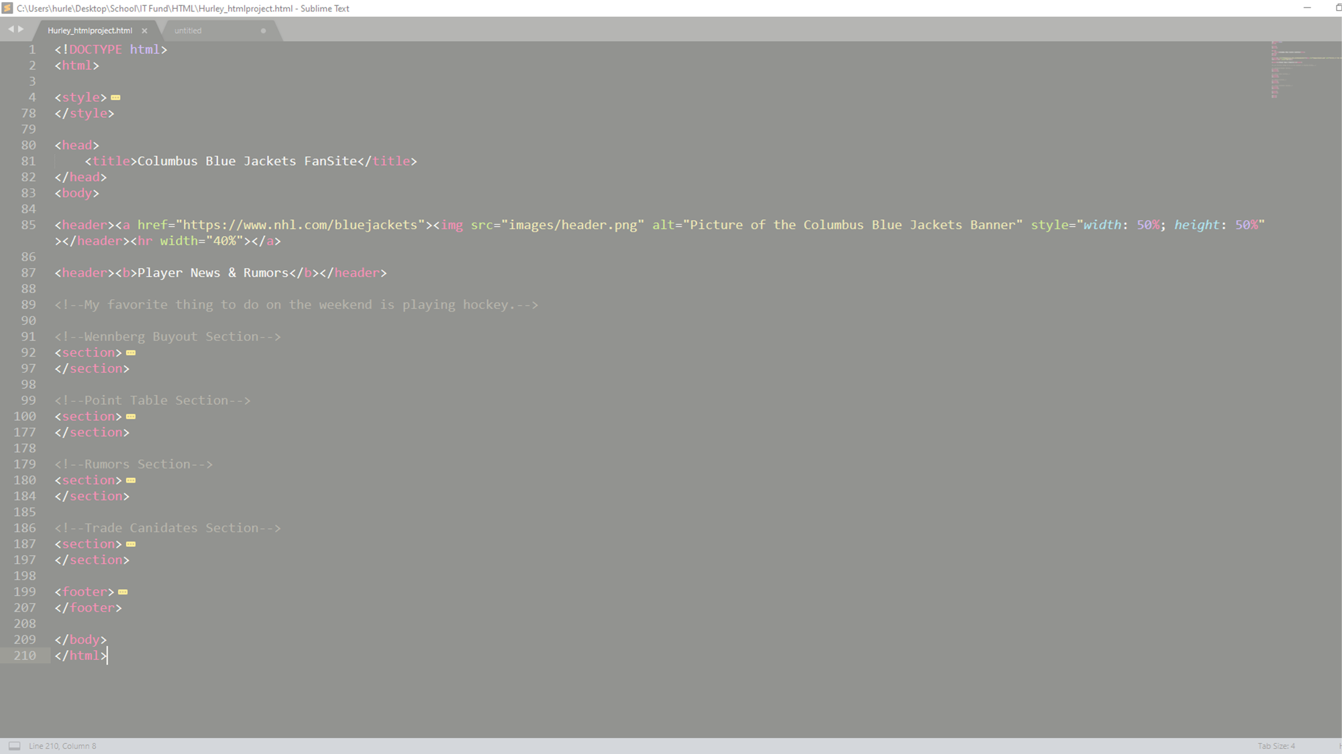
CHALLENGES
Finding and Deleting Unnecessary Style Attributes
Making the Table Visually Appealing
Spell Checking
Proper Tag Usage

Slide 5
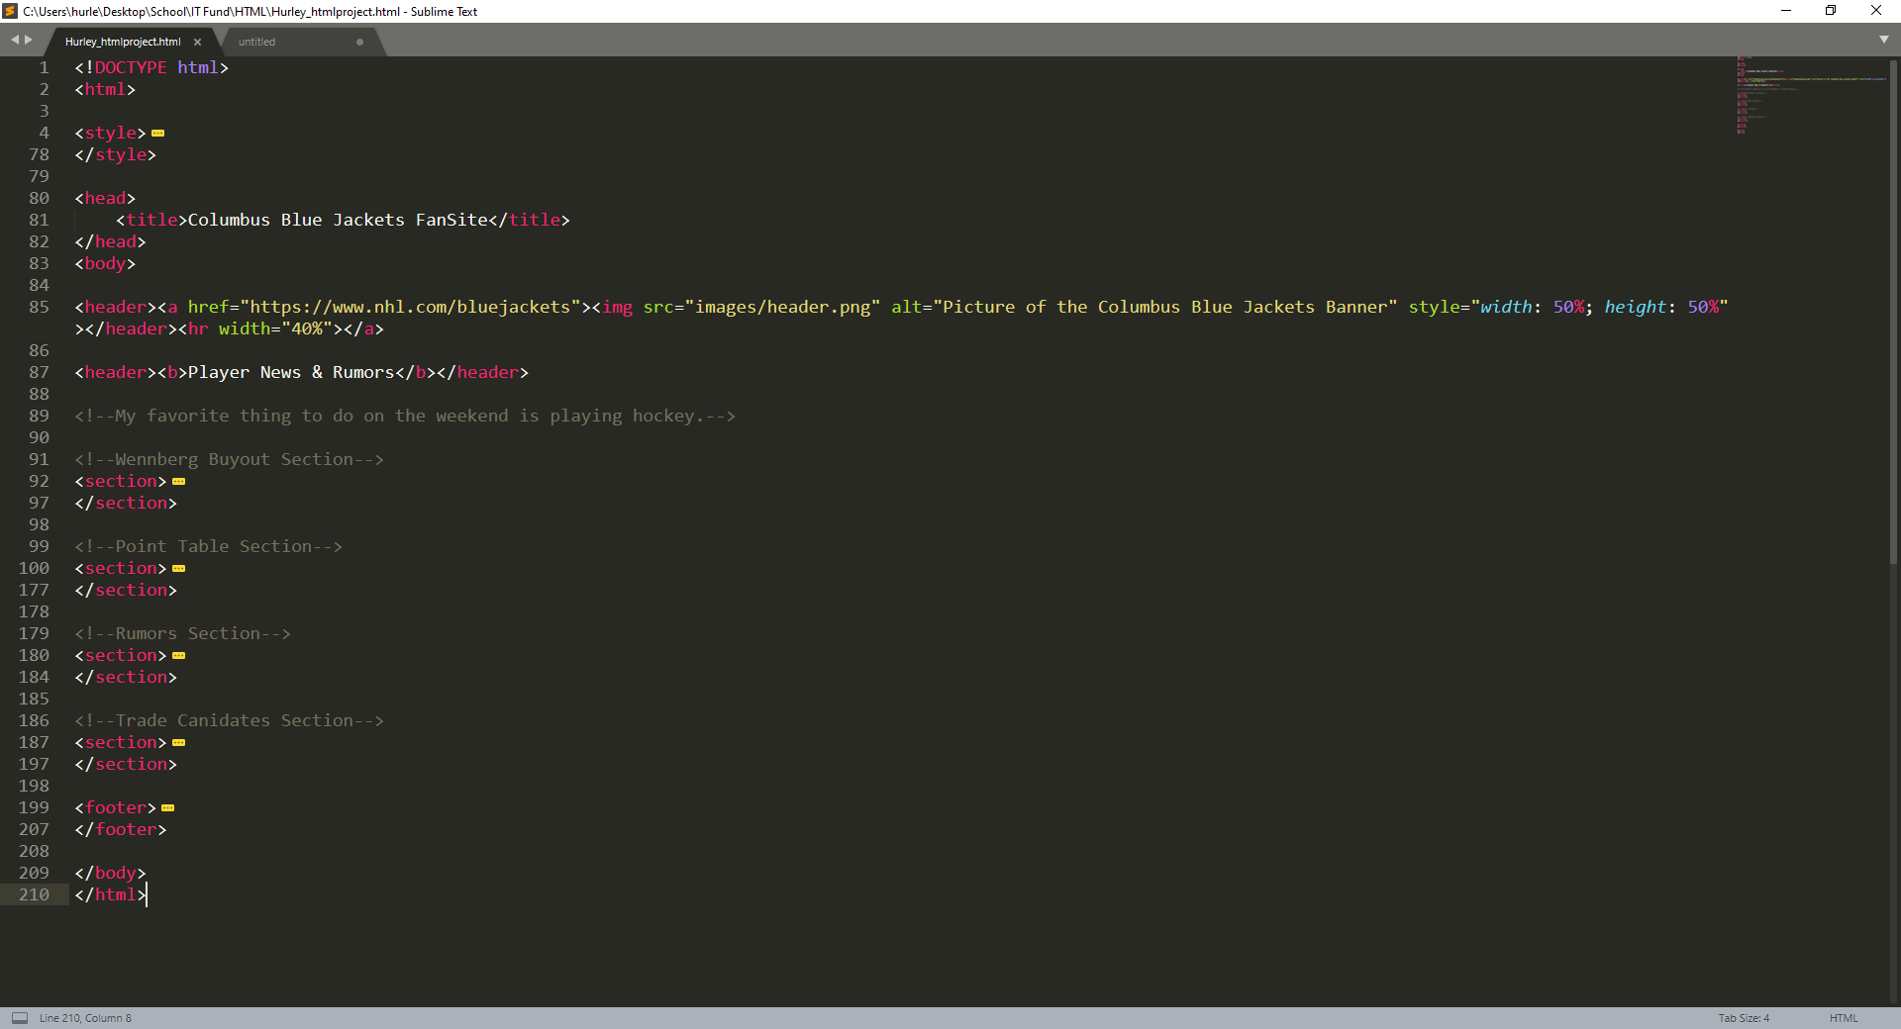
Tips & Tricks
The Ability to Style Multiple Elements at One Time
Use of Semantics and Comments Making the Code Easier to Navigate

Slide 6
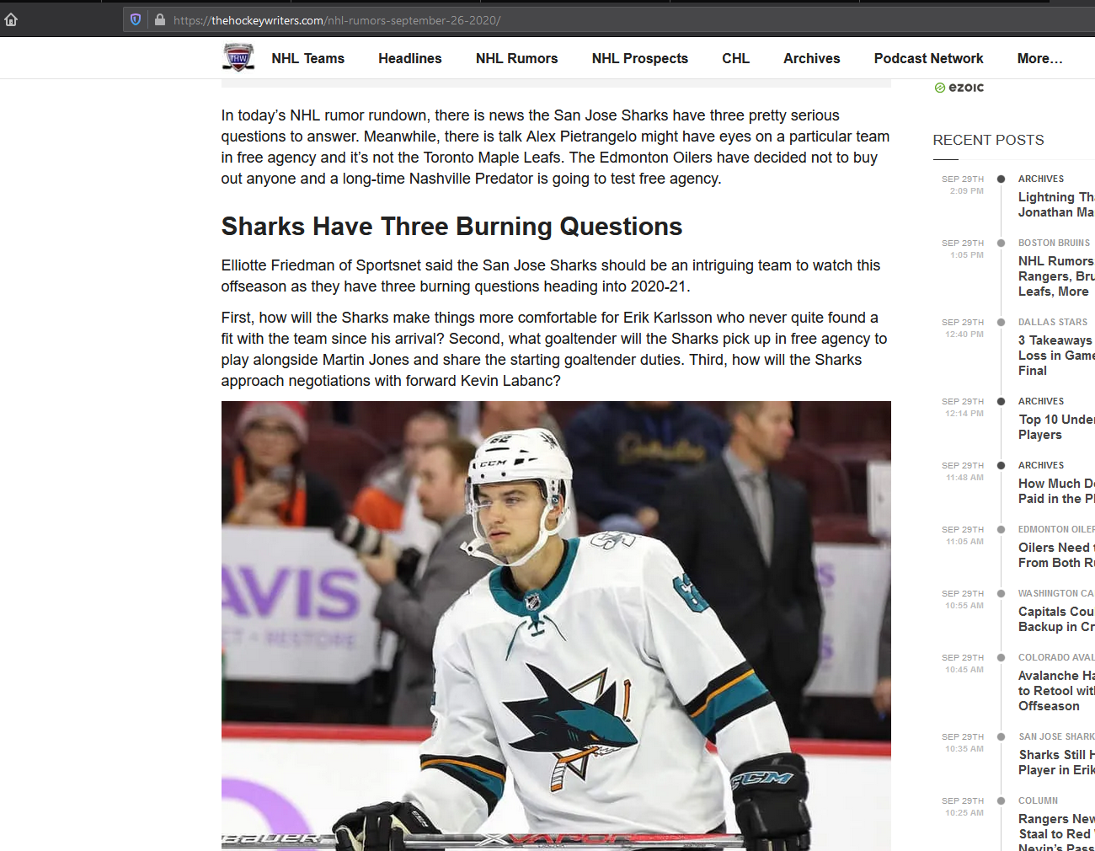
Good Example
An example of a good webpage that shares hockey news is www.TheHockeyWriters.com. This webpage is easy to follow, visually.

Slide 7
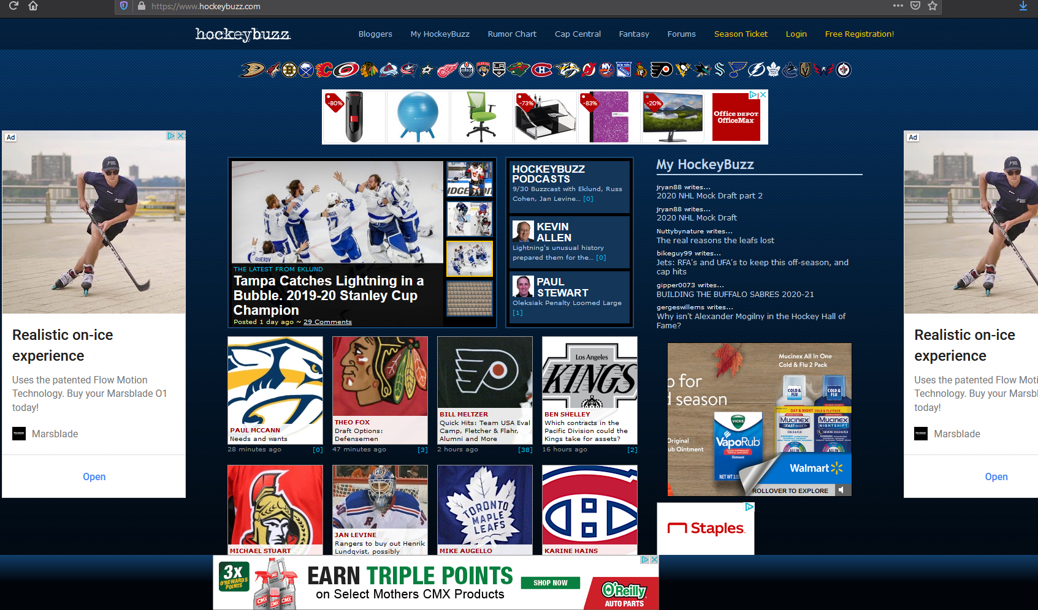
Bad Example
The picture on the right is a hockey news website that isn’t visually appealing at all. It looks cluttered from every angle.
www.HockeyBuzz.com

Slide 8

Title & Headers
The title I used for my webpage is “Columbus Blue Jackets FanSite”. The main header can be seen displaying the Columbus Blue Jackets banner logo along with “Player News & Rumors”. Header 1. Is used to display a header before each paragraph.

Slide 9

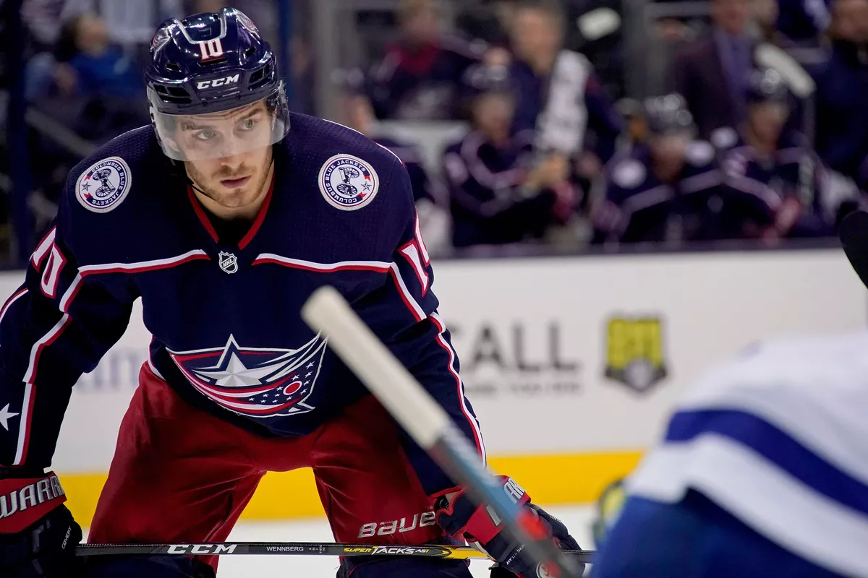

IMAGES
Each image shown on the webpage contains a hyperlink, redirecting the user to the image's original location. The images also provide “alt” text for additional accessibility.

Slide 10
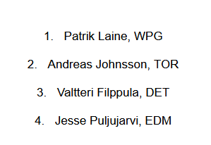
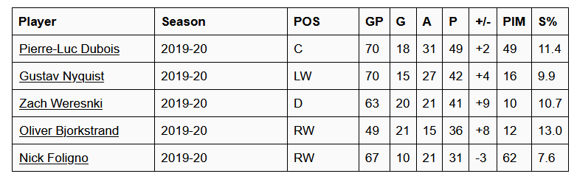
List & Table
The ordered list shown on my webpage is numbered from one to four. The table seen on the right contains 10 cells; players name, season, position, games played, goals, assists, points, plus/minus, penalty minutes, and shooting percentage for the 2019-20 season. Player names when clicked, redirect the user to their hockey-reference page.

Slide 11
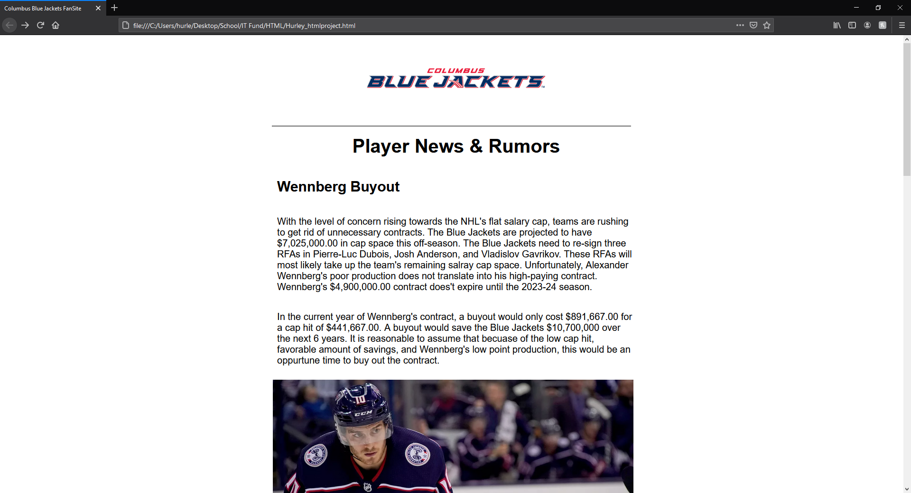

Slide 12
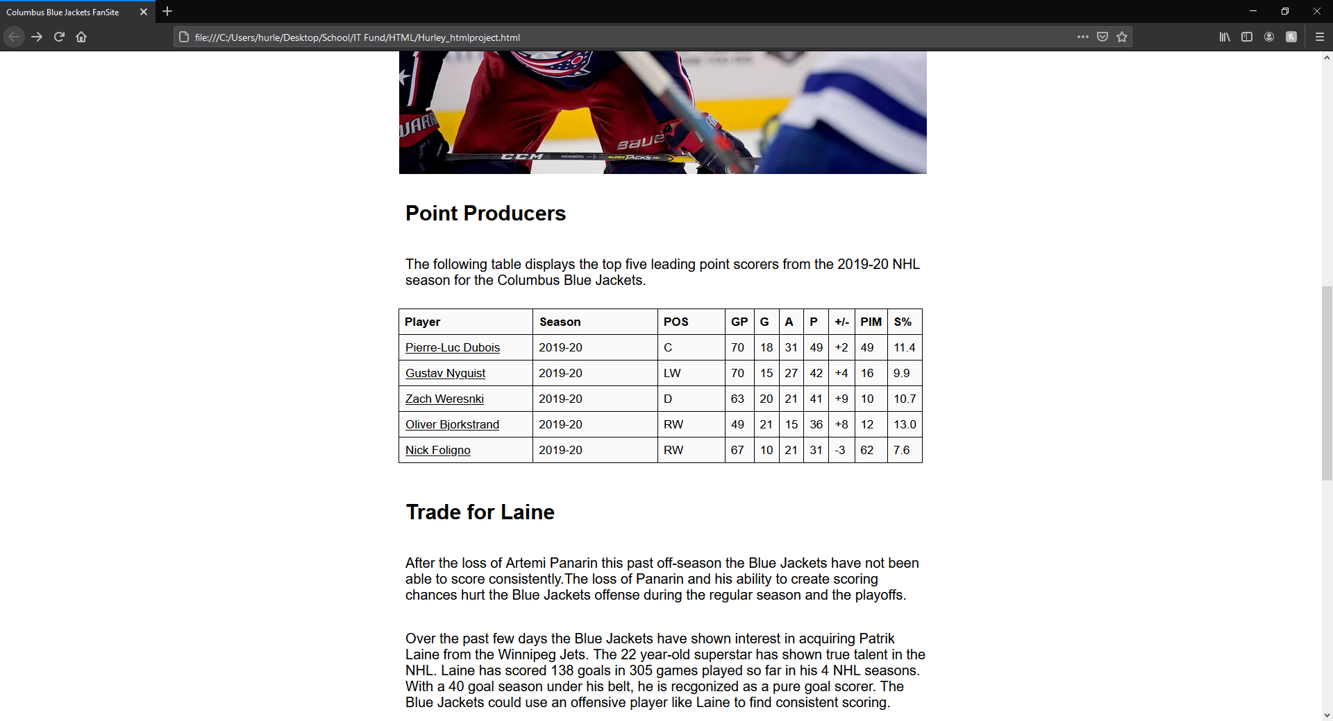

Slide 13
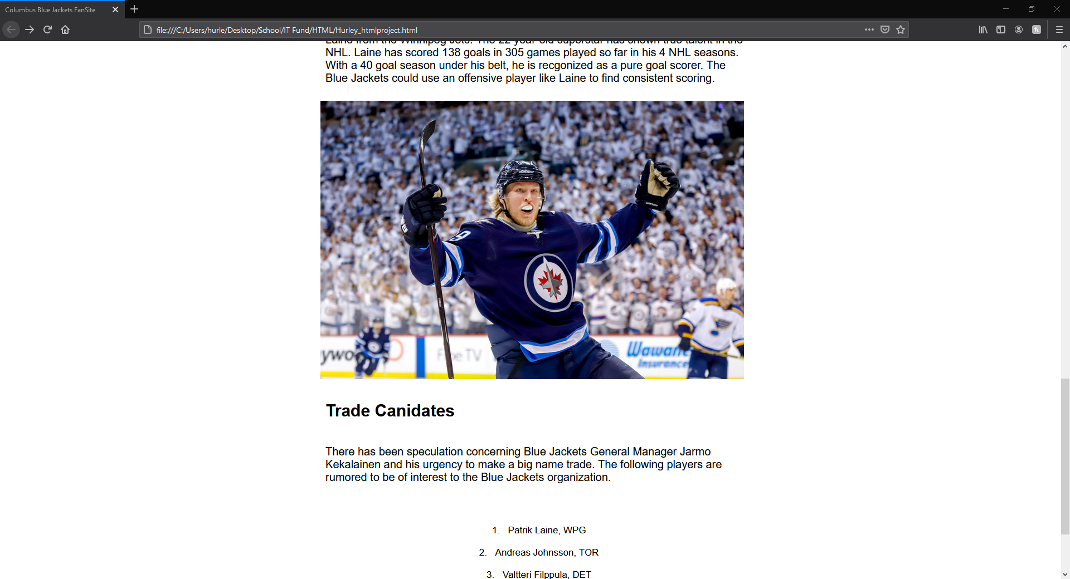

Slide 14
